Slide 1
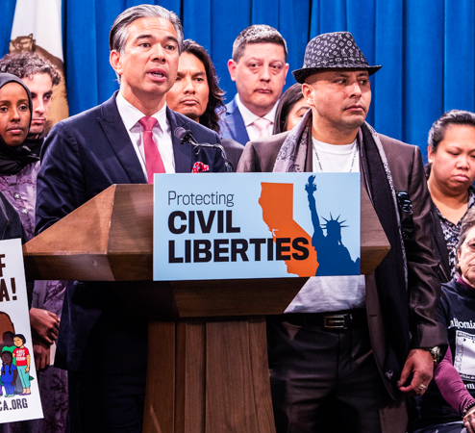

Rob Bonta
Stories of excellence
Human Relations, Diversity & Equity
Student support and attendance services
Notes:
Teacher, thank you for choosing this Advisory Lesson to share with your class!

Slide 2
Welcome
Would you rather...
Make music
Listen to music
Notes:
Pelase invite the students to engage in this check in question.

Slide 3
Objectives
Learn about California Attorney General Rob Bonta.
Review this historic nomination.
Reflect on the intersection of race and gender in politics.
Notes:
Read the objectives aloud for the students.

Slide 4
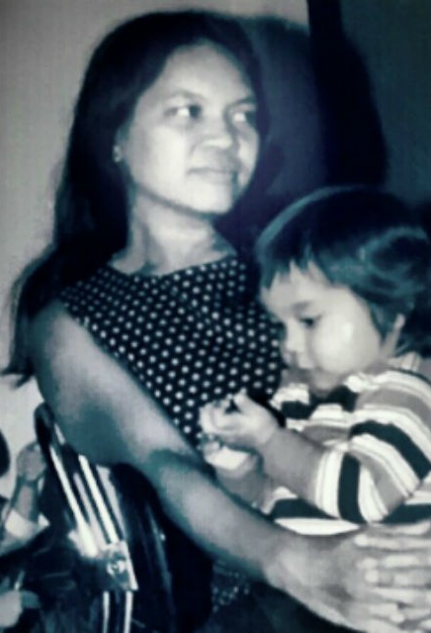
THE Son of activists
Rob was born in the Philippines in 1972 and grew up the son of activists.
His mother, Cynthia immigrated to California in the 1960s and his father, Warren, grew up in Ventura Couunty.
Rob's father joined Martin Luther King Jr.’s civil rights organizing in Alabama to pass the Voting Rights Act.
Warren and Cynthia were working as missionaries in the Philippines when Rob was born, training young people to serve the needs of rural Philippine villages through service, community organizing and ministry.
Notes:
Read the slide aloud for the students.

Slide 5
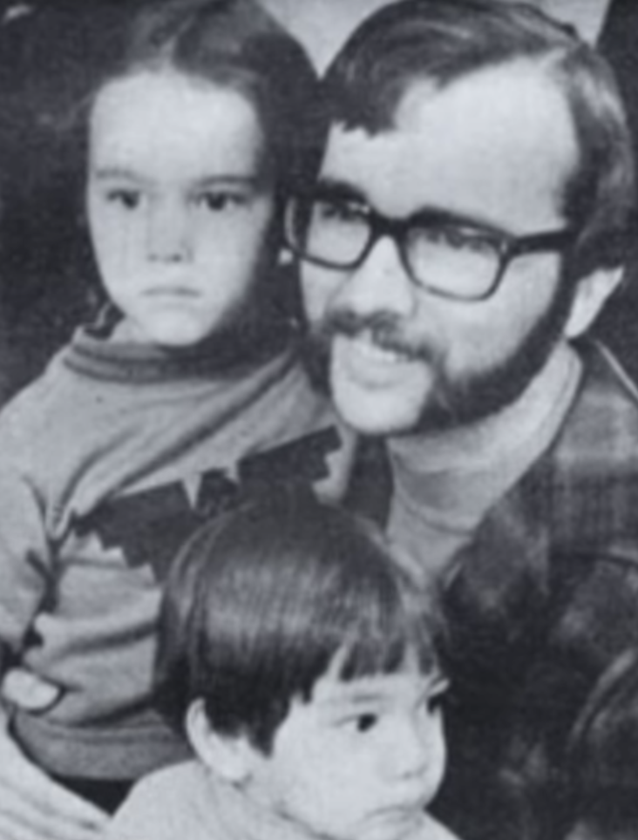
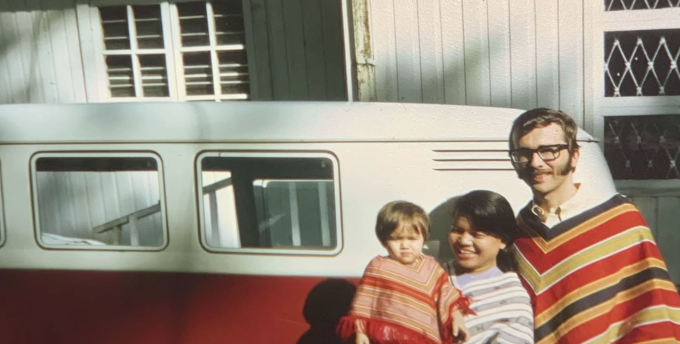

The United Farm Workers
After leaving the Philippines, Rob's family moved to a trailer near Bakersfield and served in the headquarters for the United Farm Workers movement.
Rob’s parents worked alongside Cesar Chavez, Dolores Huerta and Philip Veracruz, organizing Latino and Filipino farmworkers for racial, economic and civil rights.
His dad worked in the front office and helped set up health clinics for the farmworkers, while his mother worked at the daycare, Casa de Nana, to support farmworker organizer families.
Rob’s padrino, or godfather, Jose Gomez, was the Executive Assistant to Cesar Chavez.
Notes:
Read the slide aloud for the students.

Slide 6

Reflection
We just learned a lot about how Rob was raised by activist parents. Do you think his parents' activism impacted him as he was growing up. Why or why not?
Notes:
Engaeg the students in the reflection question.

Slide 7

Education
Rob played soccer in high school and graduated as the valedictorian.
Rob attended Yale University and graduated cum laude with his B.A. in history in 1993, and with a Juris Doctor in 1998.
Rob moved back to California to work as a lawyer, pro-bono to protect Californians from exploitations and racial profiling.
Notes:
Read the slide aloud for the students.

Slide 8
First filipino american to serve in california state legislature
In 2012, Rob became the first Filipino American in California History to be elected to the legislature, representing California State Assembly's 18th District in 2012.
Some of the major legislation Rob took part in include:
Outlawing For-Profit Prisons in California
Taking on Big Polluters
Passing Nation’s Strongest Statewide Renter Protections
Fighting to Strengthen Hate Crime Laws & Protect Communities
Protecting Immigrant Families from Deceptive ICE Tactics:
Requiring Independent Investigations of Unarmed Deaths
Notes:
Read the slide aloud for the students.

Slide 9
Reflection
In 2012, Rob Bonta became the first Filipino American to serve on the California state legislature.
Why do you think it took so long?
Notes:
Engage the students in the reflection question.

Slide 10
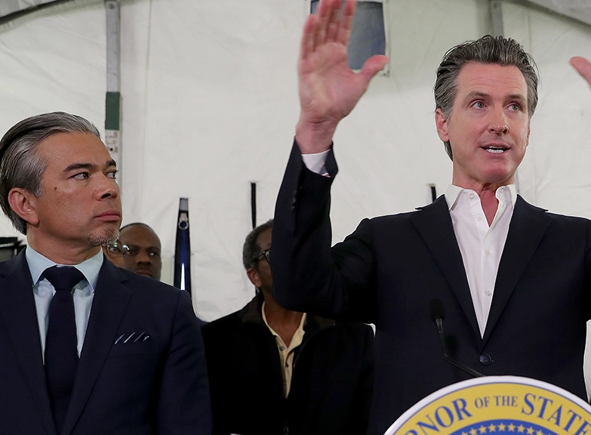
First Filipinio aMERICAN NOMInATED FOR aTTORNEY gENERAL OF cALIFORNIA
On March 24, 2021 California Governor Gavin Newsome nominated Rob Bonta to be the next Attorney General for the state of California.
Once approved by the state legislature, Rob Bonta would be the first Filipino American to serve as Attorney General for the state of California!
Notes:
*At the time this presentation was created, author could only find one other state with a Filipino American AG – Utah – Rob Bonta may be only the 2nd EVER Filipinio American State Attorney General once confirmed.
Read the slide aloud for the students.

Slide 11
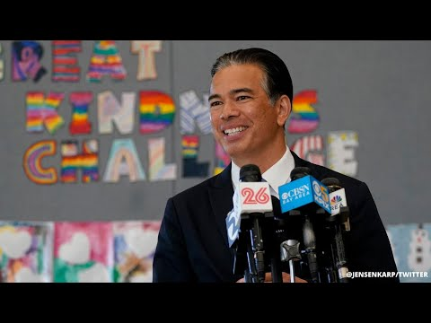
Notes:
Play the video for the students (3:11)
https://www.youtube.com/watch?v=jvHnRe3dChc

Slide 12
Reflection
Think about all that has happened for the Asian and Asian American Pacific Islander communities in this past year.
What might the nomination of Rob Bonta be extra important in this moment?

Slide 13
Check out
Which type of pet woud you prefer?
Dog
Cat
Turtle
Notes:
Engage the students in the check out question.

Slide 14
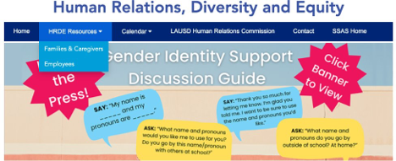
For additional resources, visit us at: https://www.lausd.org/human-relations

Slide 15

Teacher Feedback
Notes:
Teacher, please complete a brief feedback survey by scanning the QR code

